Slide 1
Group Project CO559 By:
Enkh-Amgalan (Entwan) Enkhbayar (22135347)
Muneef Ahamed Mohamed Mumthas (22206529)
Crown Caesar (22038807)
Brunaldo Cimo (22209954)

Slide 2
Introduction
Objective: Apply machine learning algorithms and Deep learning Neural Network to classify species in the Iris dataset.
Datasets Overview: 1. Consists of measurements from three species of Iris (setosa, versicolor, virginica). 2. Consists of images of three different species of iris.

Slide 3
Machine Learning
With Iris CSV Dataset

Slide 4

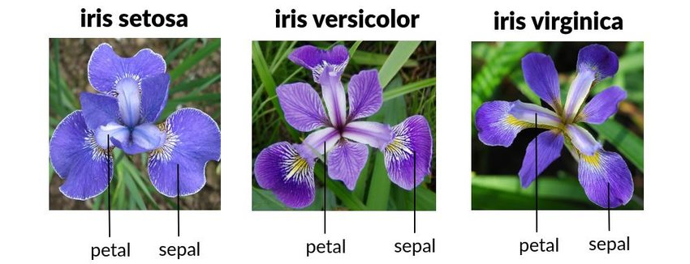
Classification Analysis and ML prediction on Iris Dataset

Slide 5
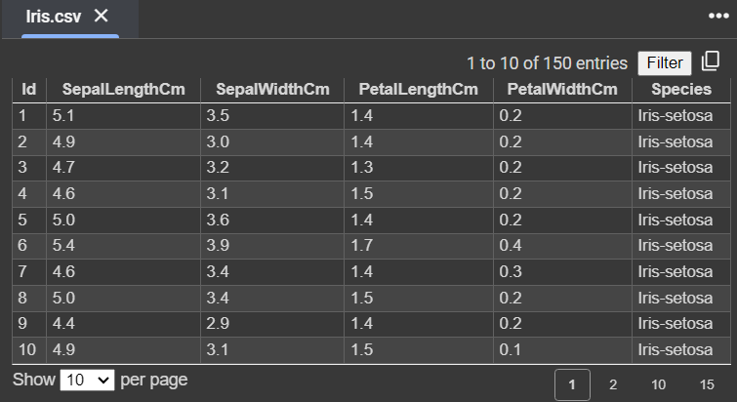
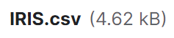

Iris CSV dataset

Slide 6
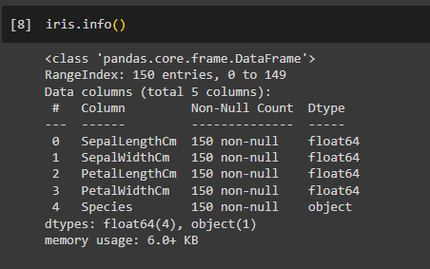
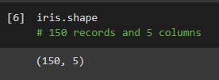
Iris csv dataset info

Slide 7
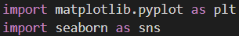
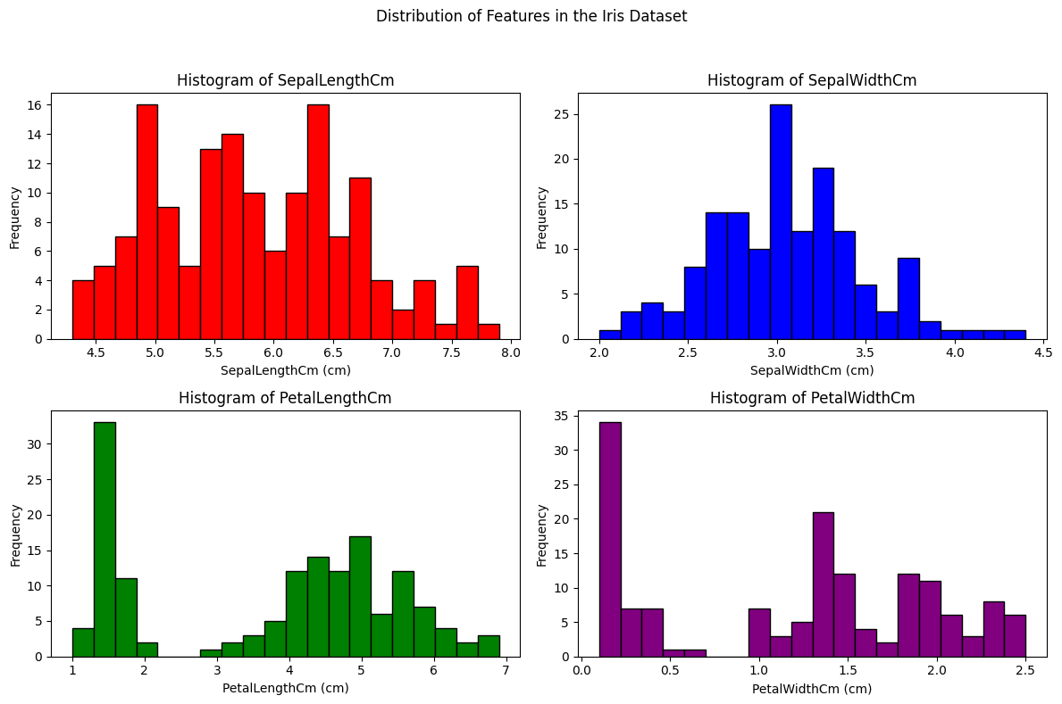
Distribution of Features in the Iris Dataset

Slide 8
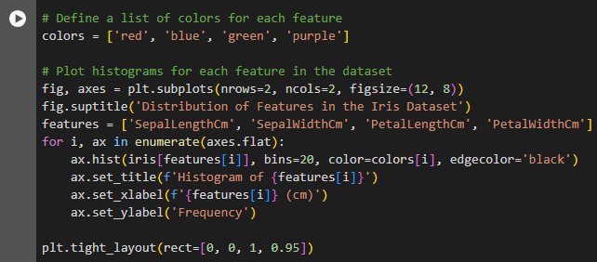
Code block for Histogram

Slide 9
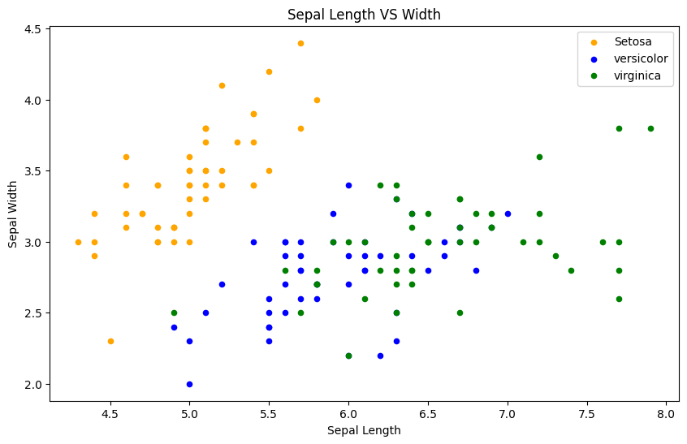
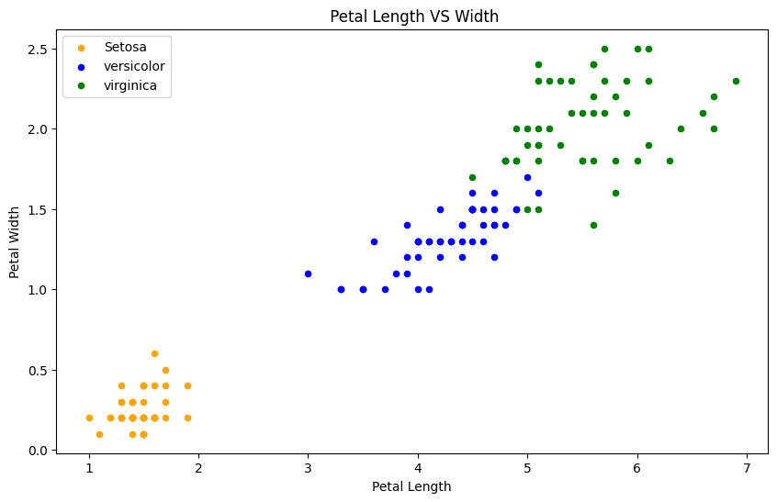
Width and Length of Petal and Sepal difference between all three Flowers

Slide 10
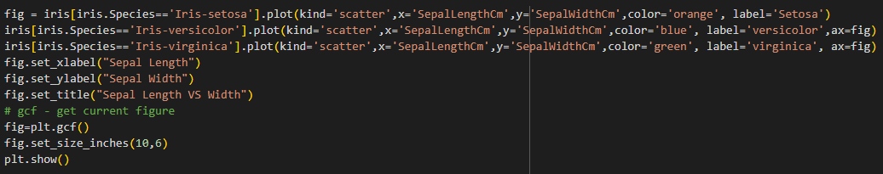
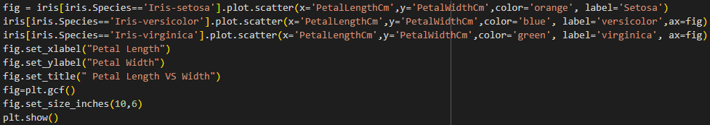
Code blocks for Scatter Plot

Slide 11
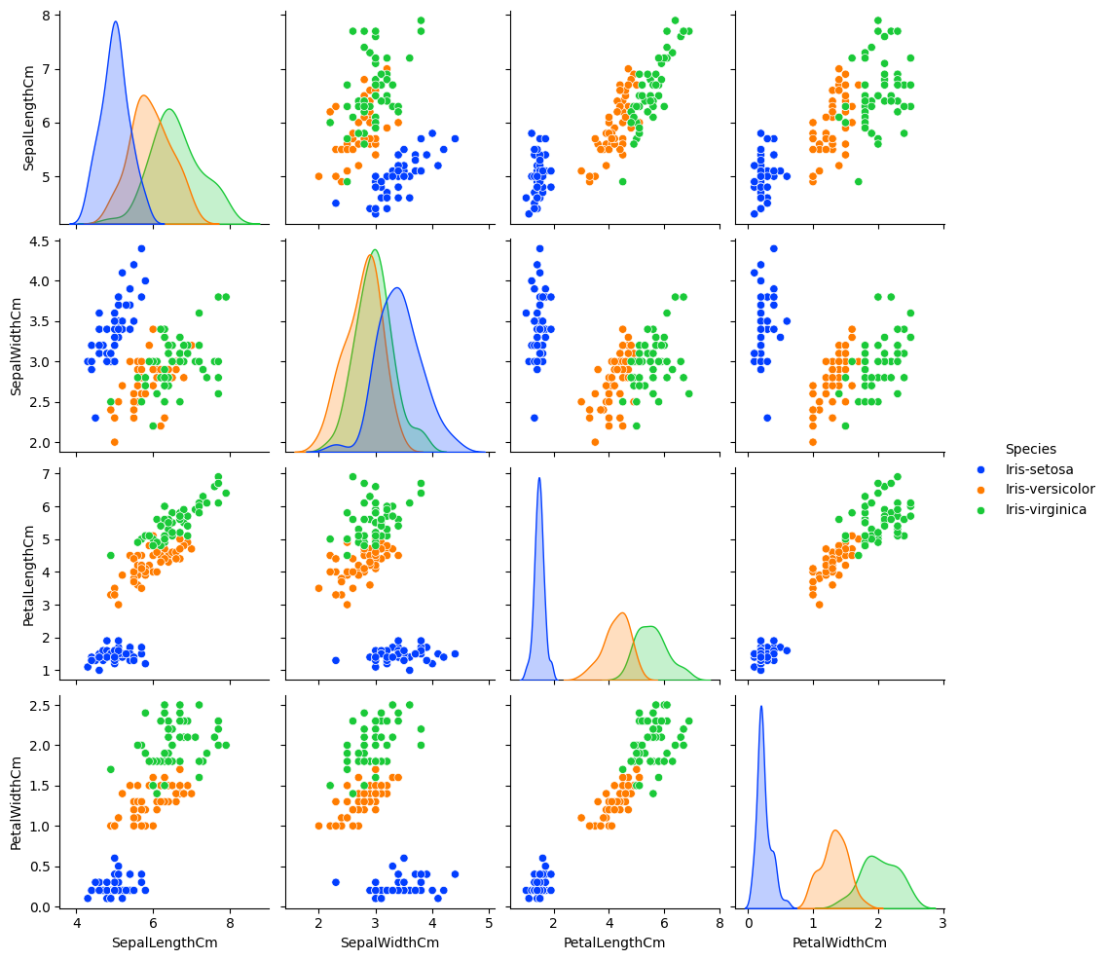
Iris Dataset Pairplot

Slide 12
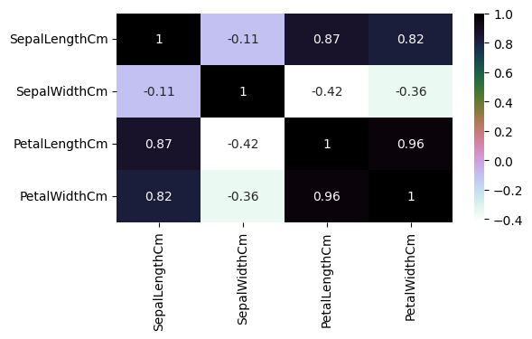
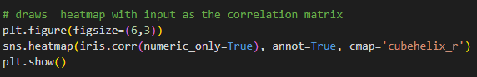
Iris Dataset Heatmap

Slide 13
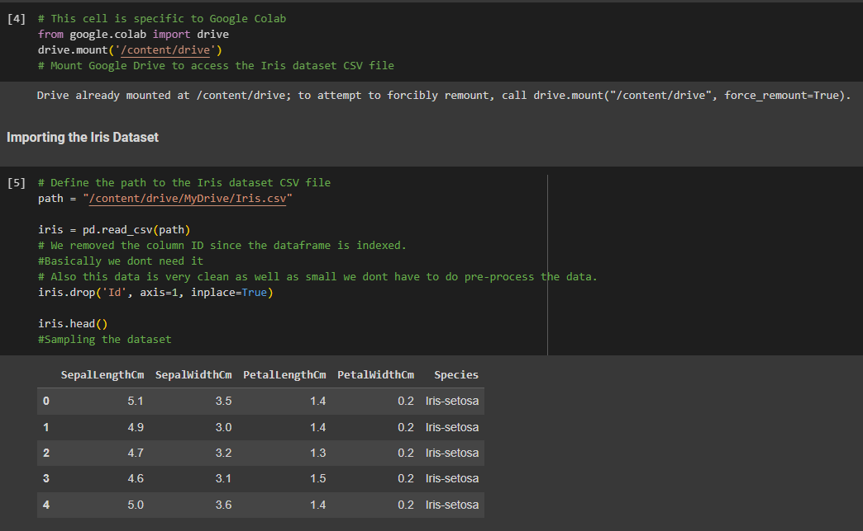
Loading the dataset into data frame using pandas

Slide 14
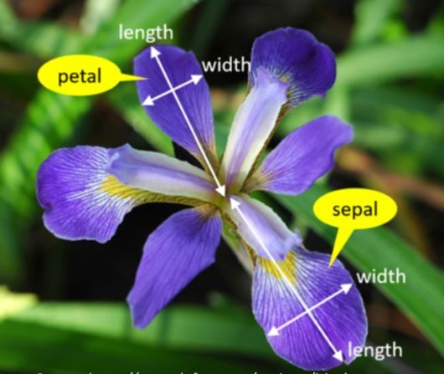
Methodology
Algorithms used: Decision Tree, Logistic Regression, SVM, KNN.
Preprocessing: Data normalization, handling missing values.
Model Evaluation: Confusion matrix, accuracy.

Slide 15
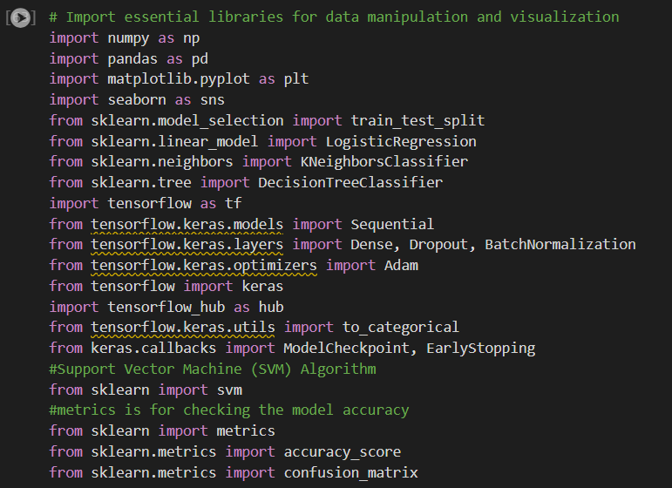
Importing all libraries

Slide 16
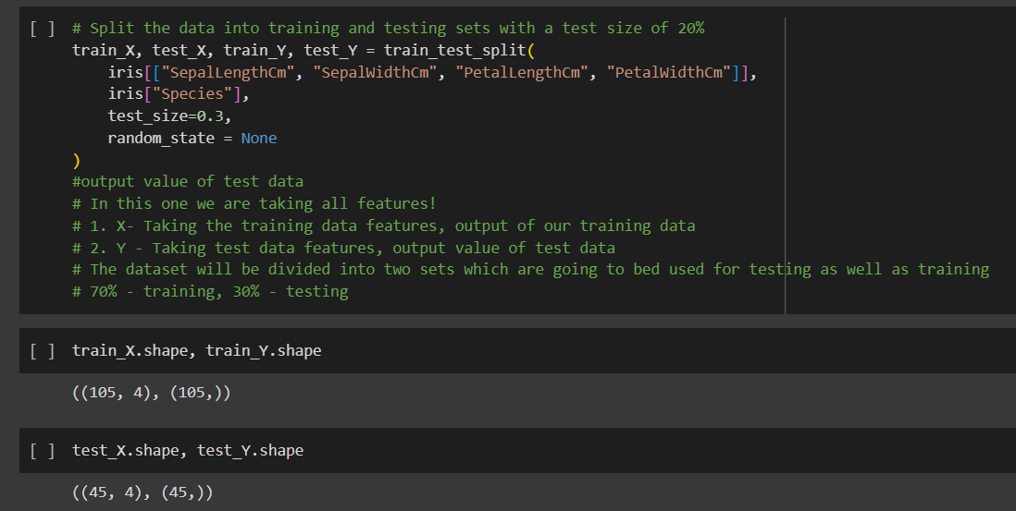
Preparing the data to feed the different algorithm models

Slide 17
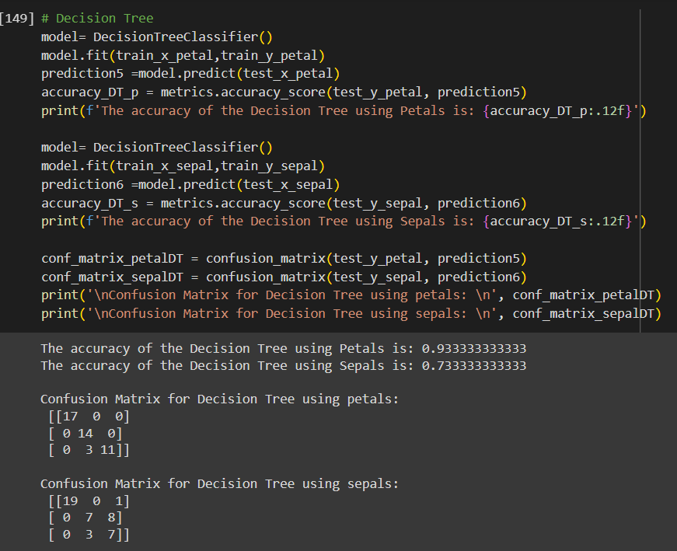
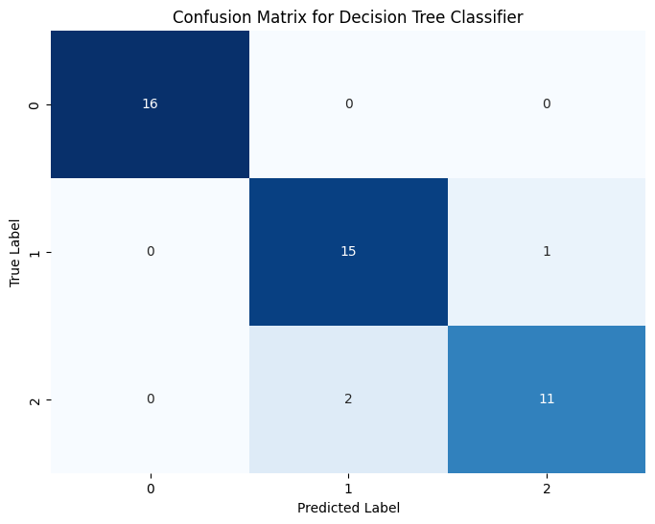
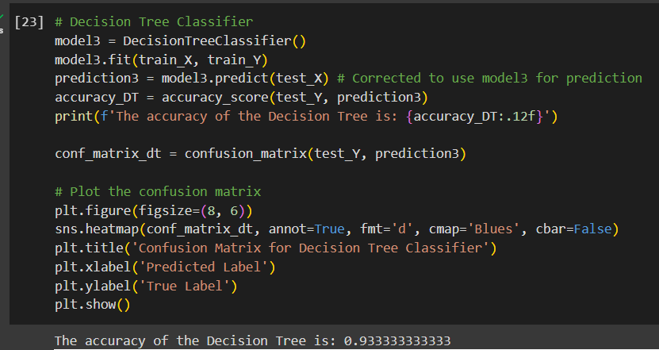
Decision Tree

Slide 18
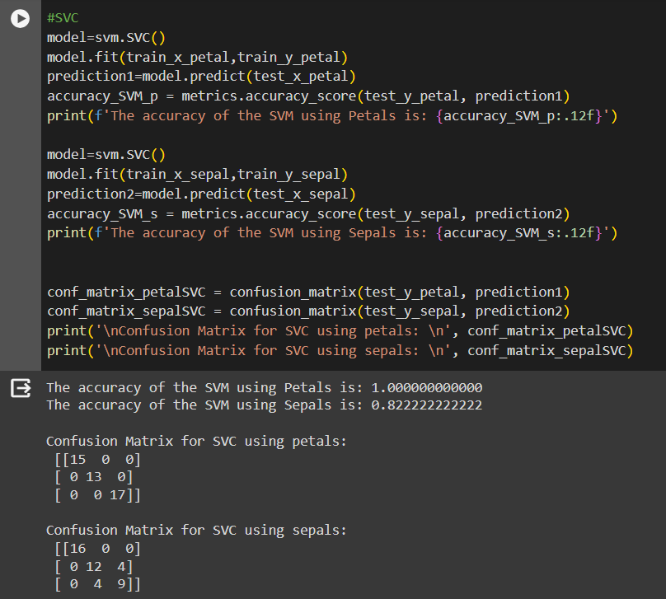
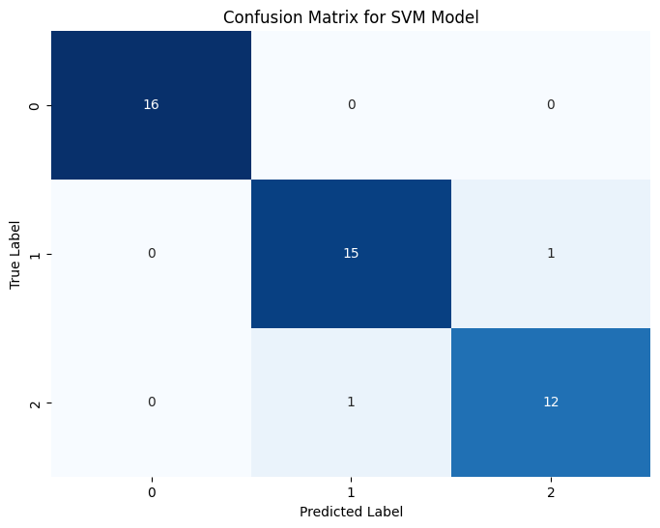
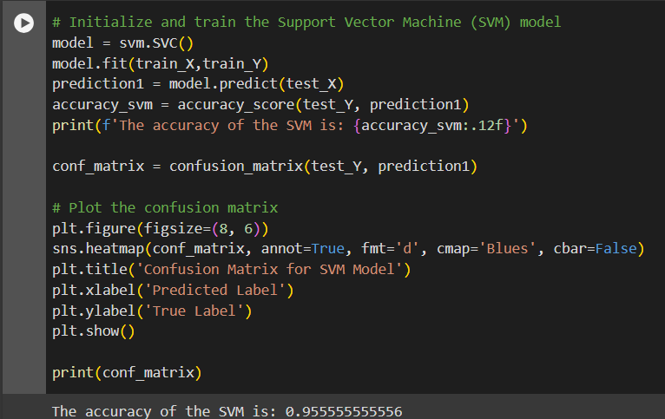
SVC

Slide 19
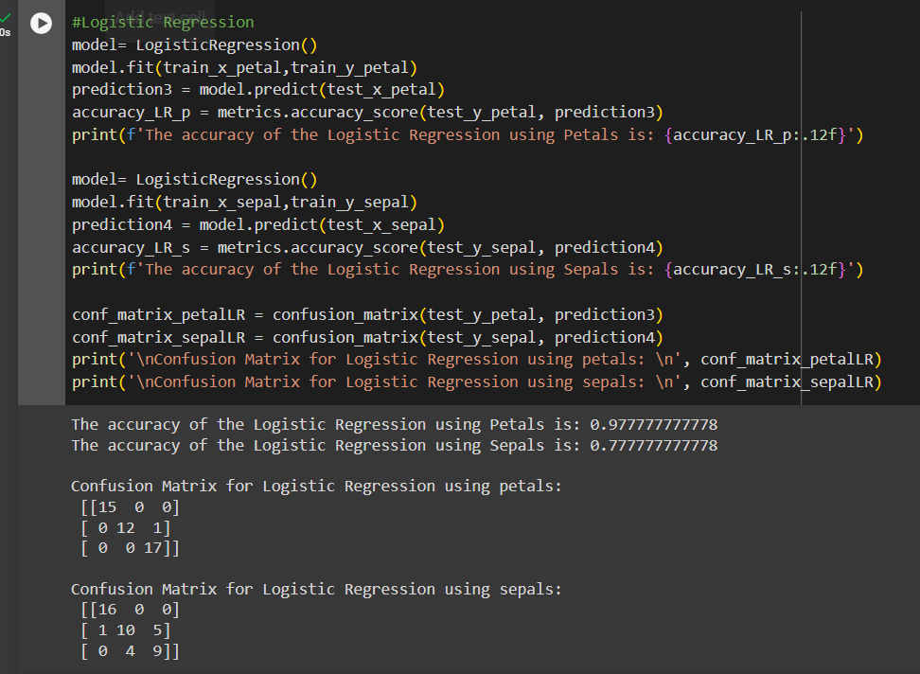

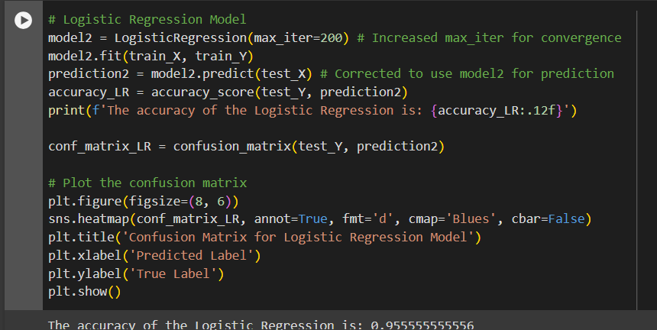
Logistic Regression

Slide 20
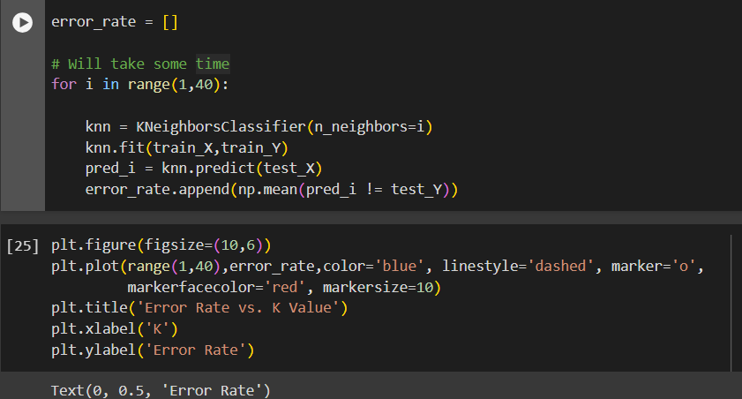
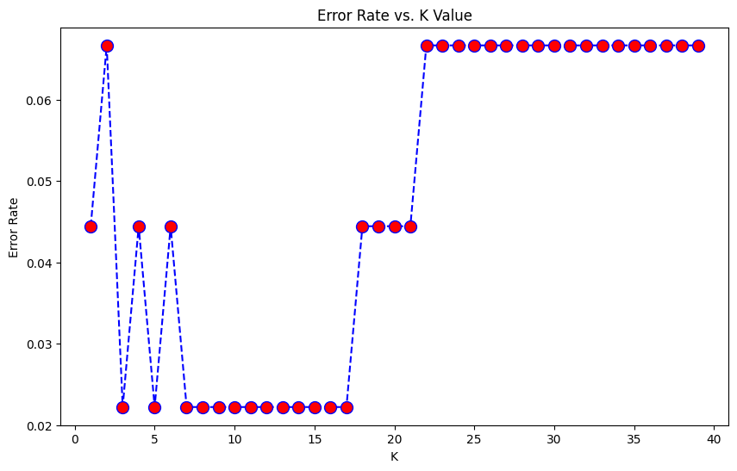
KNN Finding the perfect K- value

Slide 21
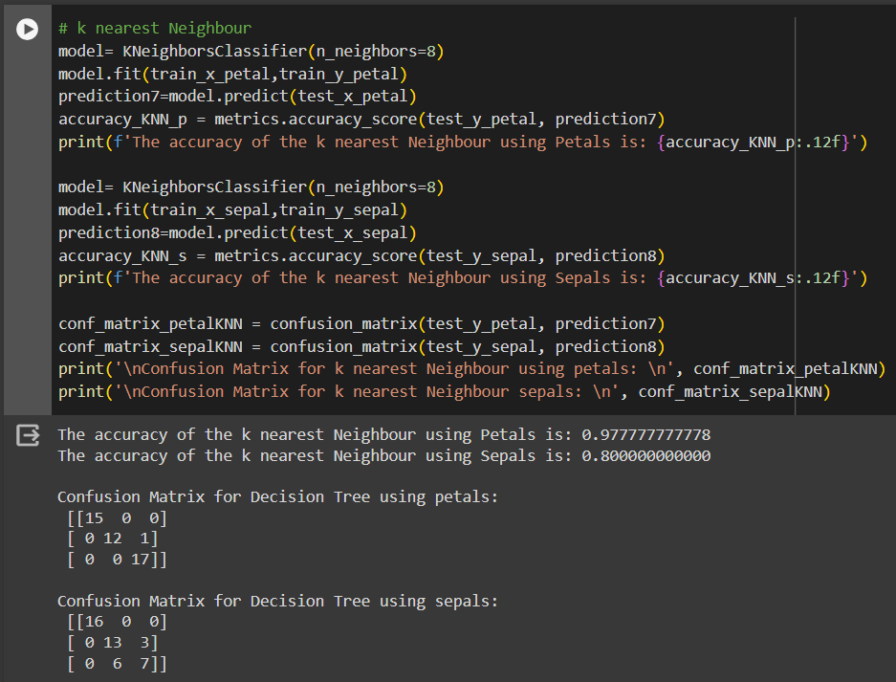
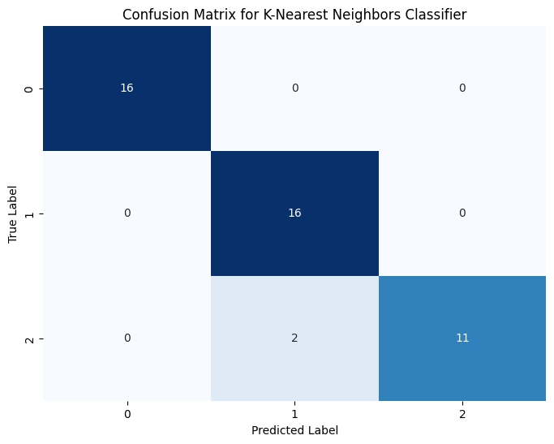
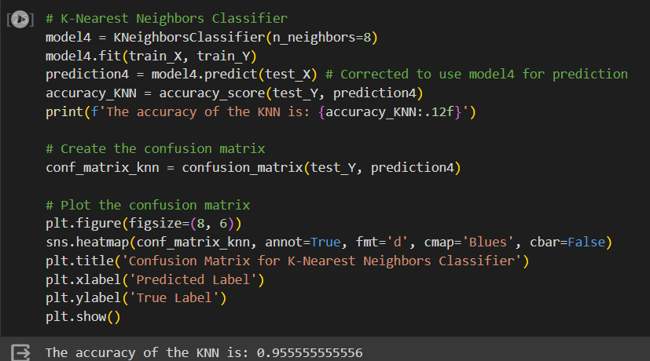
KNN

Slide 22
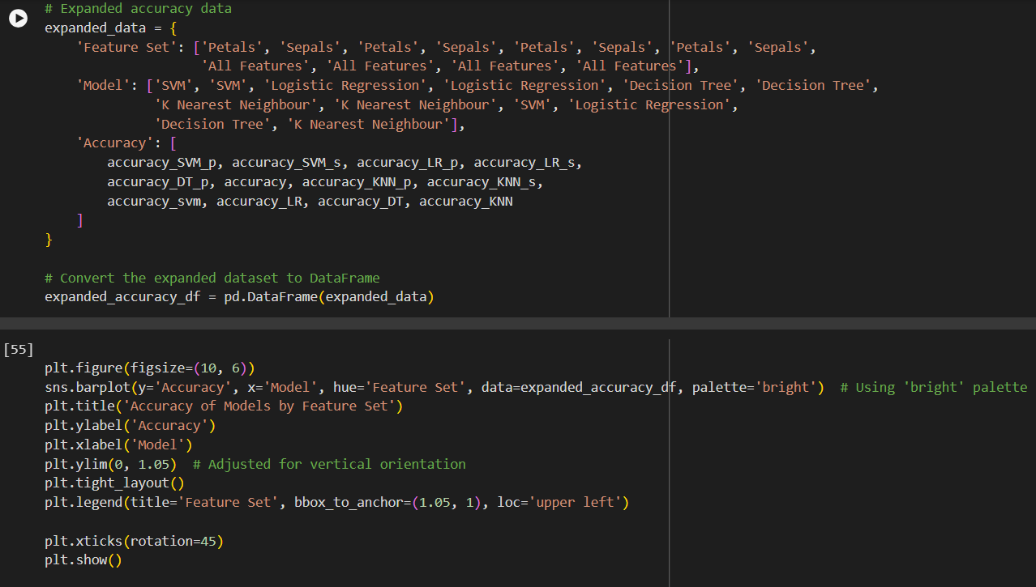
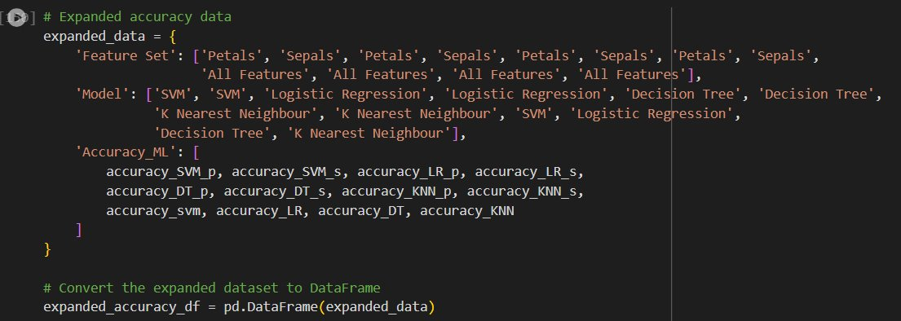
Visualised Result for Machine Learning Algorithms

Slide 23
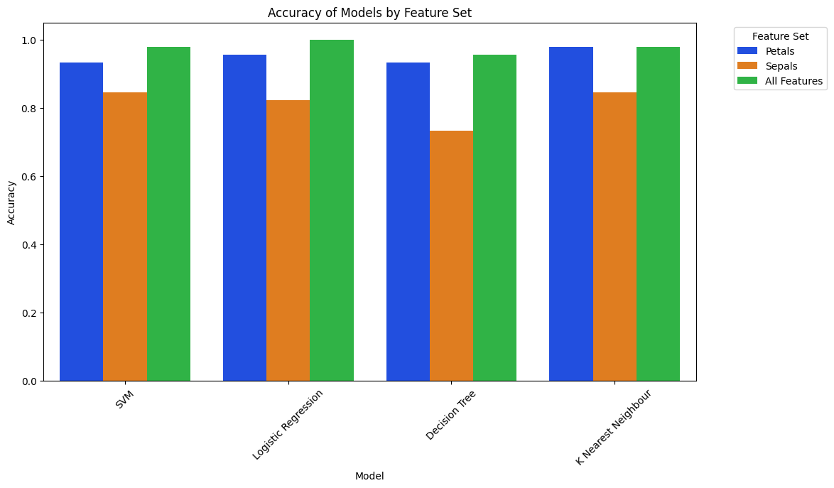

Slide 24

Discussion
Analysis of algorithm performance.
Strengths and limitations of each model.
Insights into data features and classification accuracy.

Slide 25
Logistic Regression
Strengths:
Simple and Interpretable: Easy to implement and understand.
Efficient: Fast training, performs well on linear data.
Limitations:
Linear Boundaries: Limited for complex datasets.
Outliers: Sensitive to outliers.
Binary Focus: Naturally suited for binary classification.

Slide 26
K-Nearest Neighbors (KNN)
Strengths:
Simple and Flexible: Easy to understand, works for classification and regression.
Non-parametric: No data distribution assumptions.
Limitations:
Computationally Expensive: Slow for large datasets.
High Dimensionality Issues: Performance degrades with more features.
Tuning Needed: Requires careful selection of 𝑘.

Slide 27
Decision Tree (DT)
Strengths:
Intuitive: Easy to interpret and visualize.
Non-parametric: No distribution assumptions, handles complex boundaries.
Limitations:
Overfitting: Prone to overfitting with deep trees.
Instability: Sensitive to data changes.
Needs Pruning: Requires pruning or ensembles to reduce overfitting.

Slide 28
Support Vector Machine (SVM)
Strengths:
High-dimensional Effectiveness: Works well with many features.
Kernel Trick: Handles non-linear relationships.
Limitations:
Computationally Intensive: Slow training for large datasets.
Parameter Tuning: Performance depends on kernel and parameter choices.
Less Interpretable: Difficult to interpret compared to simpler models.

Slide 29
Summary
Logistic Regression: Simple, interpretable, but struggles with non-linear data and outliers.
K-Nearest Neighbors: Flexible, simple, but computationally expensive, sensitive to dimensions.
Decision Tree: Intuitive, handles complexity, but prone to overfitting and instability.
Support Vector Machine: Excels with high-dimensional, non-linear data, but needs careful tuning and is computationally intensive.

Slide 30
Deep Learning
With Iris Image Dataset

Slide 31
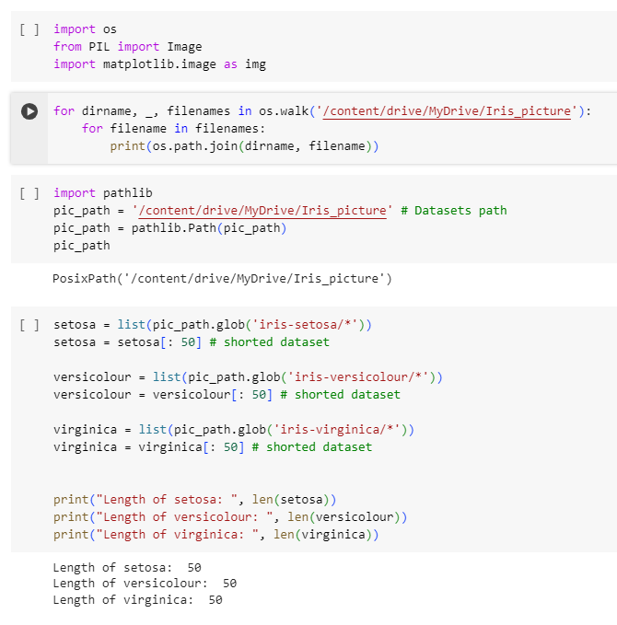
Importing the Image Dataset & shorting the data set to be 50 images per class:

Slide 32
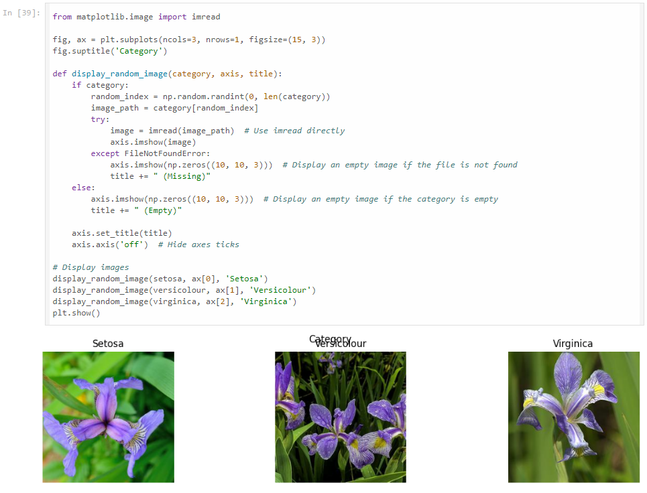
EDA: Checking out a random image of iris for each class/species:

Slide 33
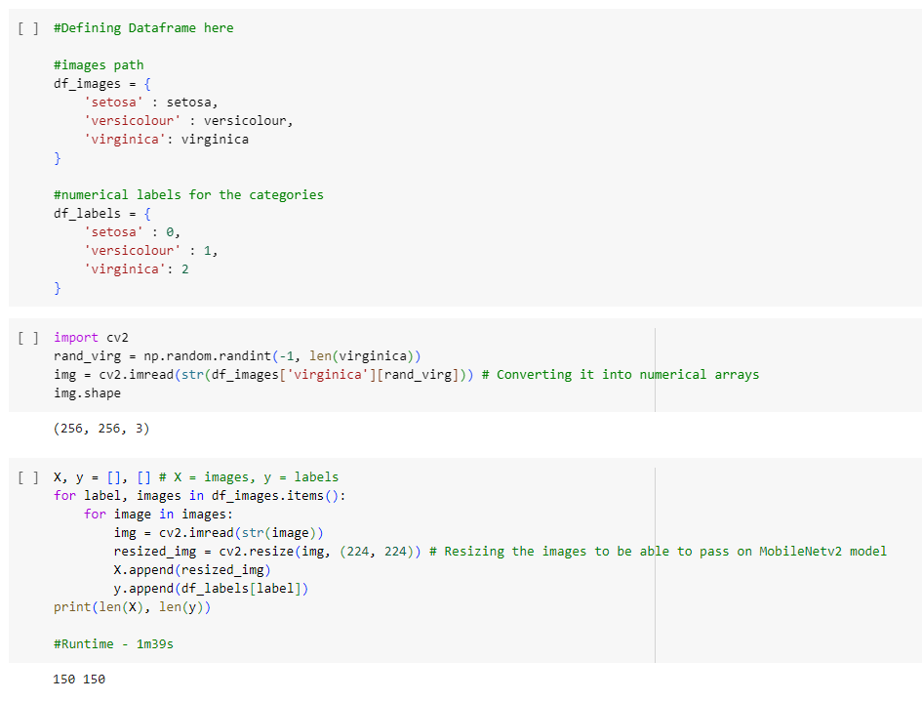
Defining the Dataframe, reading and resizing images:

Slide 34
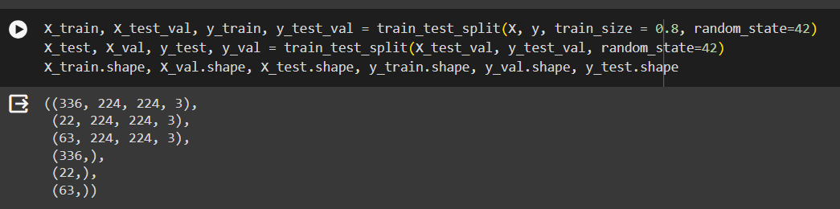
Resize all the images to fit into Input Layer 224,224,3

Slide 35
The Model 1 Architecture (4 layers)

Slide 36
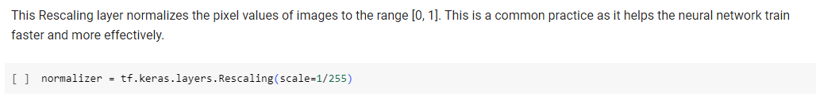
Rescaling Layer:

Slide 37
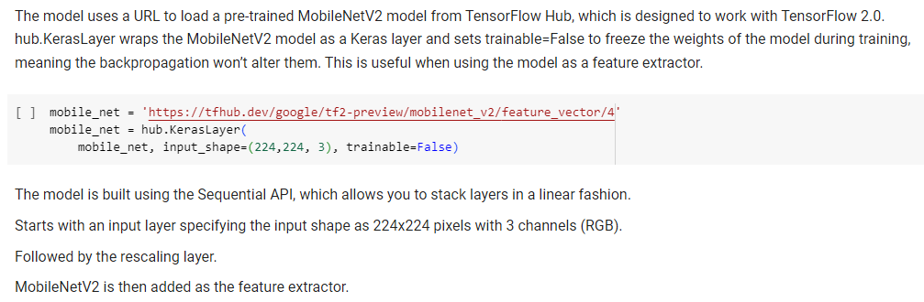
MobileNetV2 Layer:

Slide 38
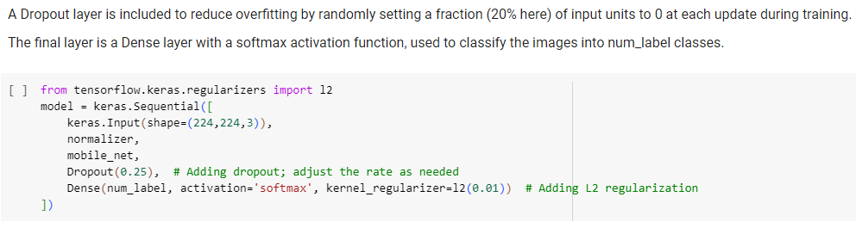
Dropout Layer
&
Dense Layer with
Softmax Activation and L2 regularization:

Slide 39
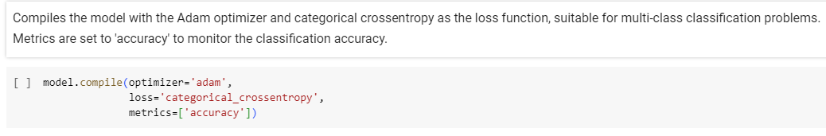
Model 1 Compilation

Slide 40
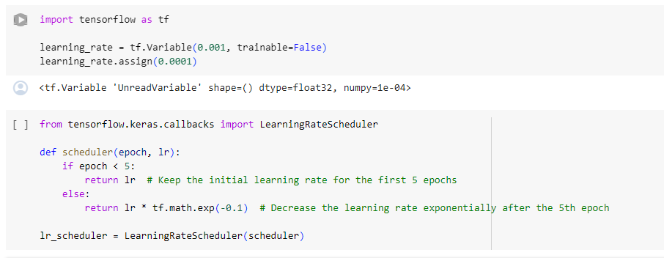
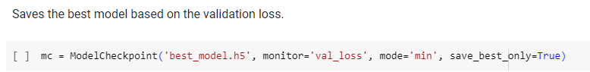
Callbacks Used in Model 1:
1 - Learning Rate Scheduler:
2 - Model Checkpoint:

Slide 41
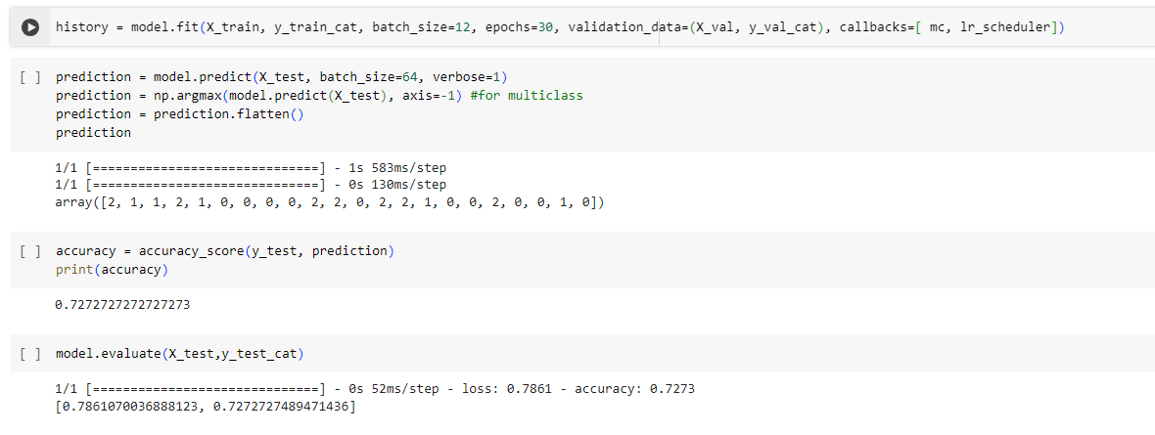
Model 1 Prediction:
Accuracy = 72.7%

Slide 42
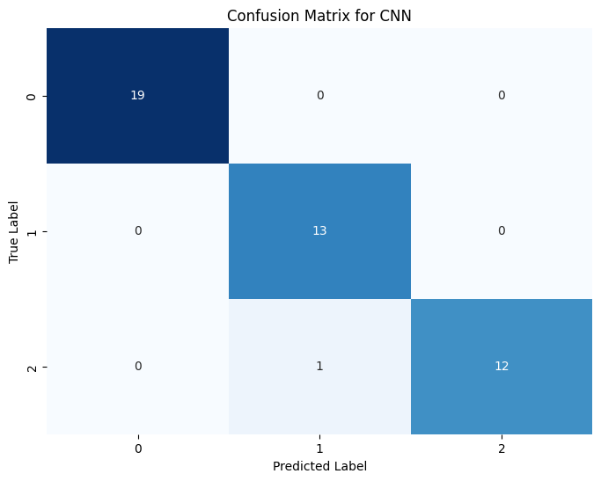
Model 1 - Visualized Result 1

Slide 43
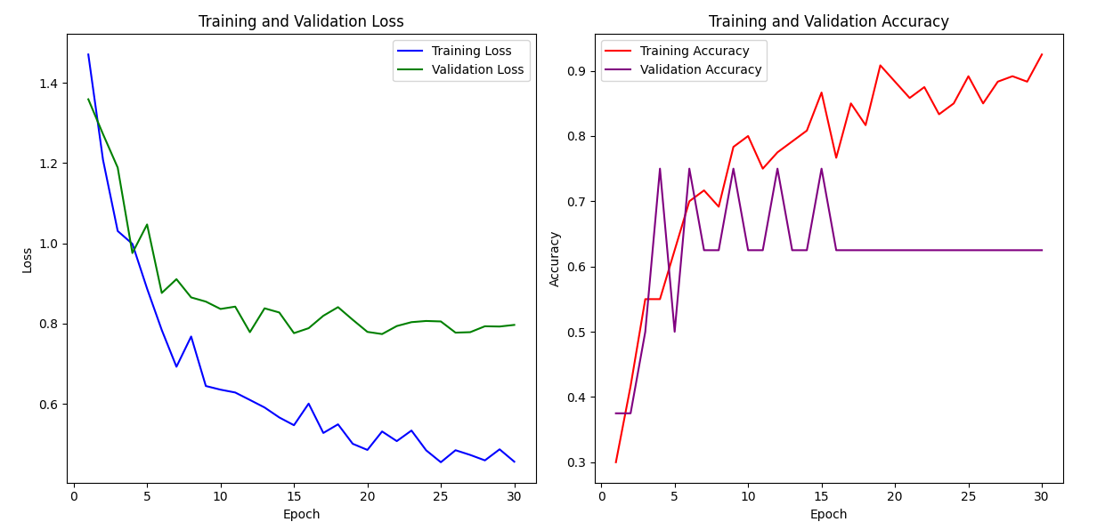
Model 1 - Visualized Result 2

Slide 44
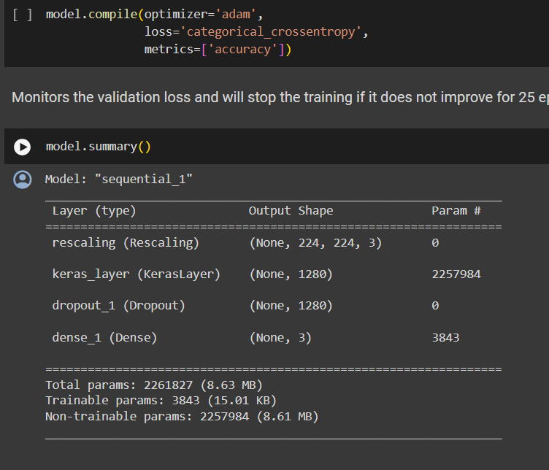
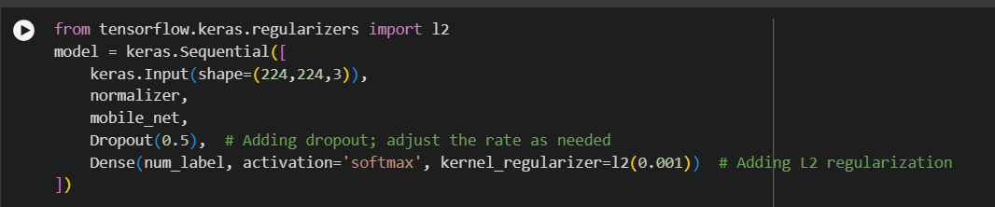
Model 2
Layers:
Rescaling Normalizer Layer
MobileNet Feature Extractor Layer
Dropout Layer with 50% rate
Dense layer with Softmax activation func and L2 regulizer with 0.001 learning rate.
Didn't balance the dataset*

Slide 45

Model 2

Slide 46

Model 2 result
Accuracy = 60%

Slide 47
Summary
Summary for model 1 and model 2 need to be added here

Slide 48
Conclusion
Project Exploratory Data Analysis (EDA) was valuable experience.
Enhanced understanding of ML and DL algorithms.
Fun and easy project :P

Slide 49

Questions & Answers
Please feel free to ask any questions or clarify doubts regarding the project.

